Slide 1
Creating reports and raising procedures
Croatia, IOF Split

Slide 2
Database (2016)
server with oracle database
application server
web based applications for data inputs, data analisys & validations, reporting tools

Slide 3
Data composition
(IOF) Meta data
(IOF) Catch weight distribution by species & category
(IOF) Length distribution
(IOF) Laboratory analisys
(Directorate of Fisheries) Landings

Slide 4
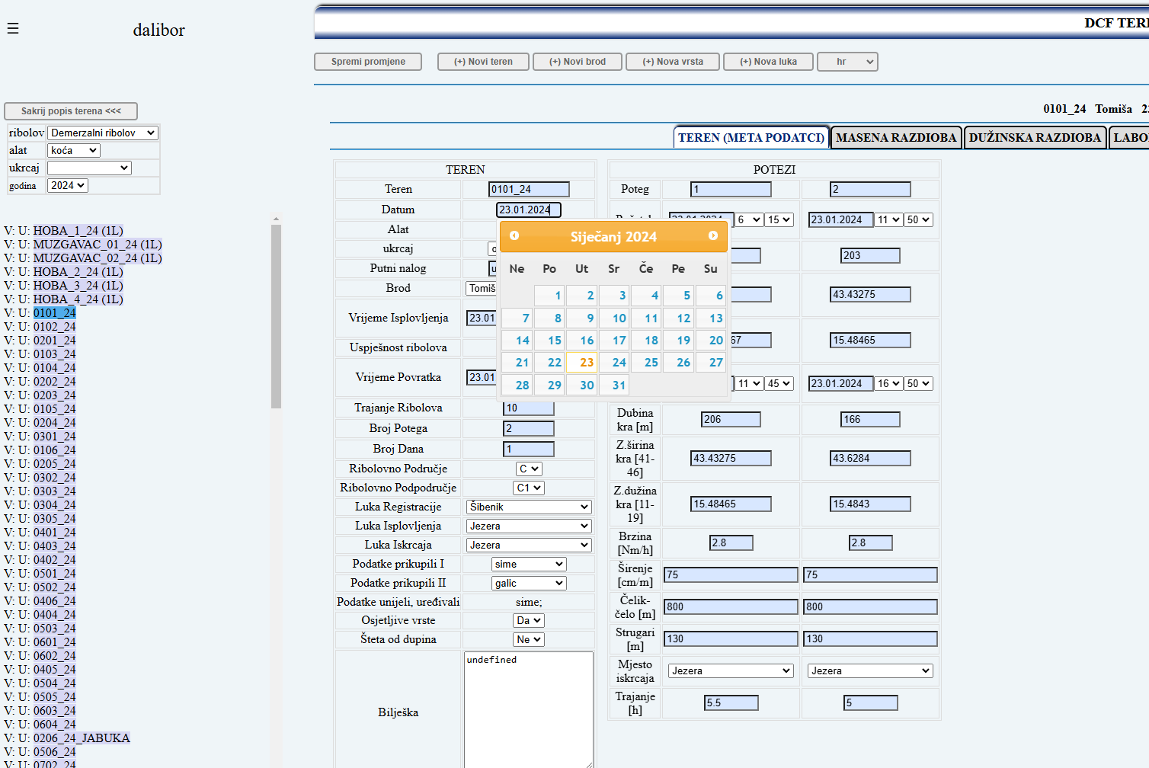
Meta data
Input using forms, datepickers, lists

Slide 5
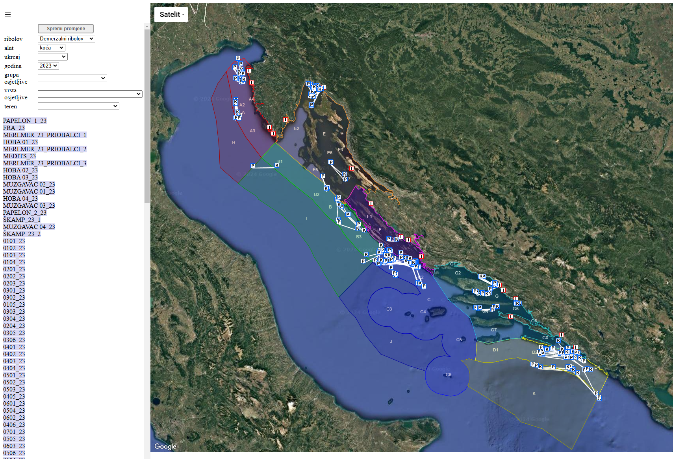
Meta data
Input using google maps api

Slide 6
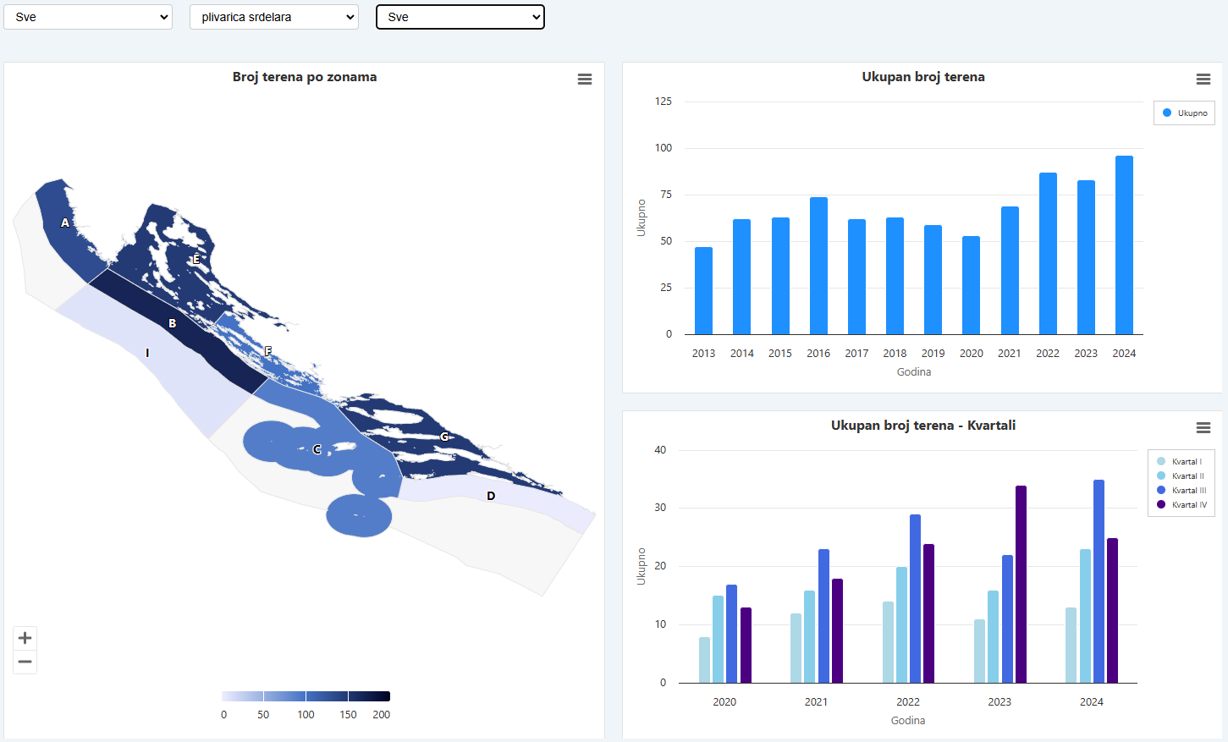
Meta data
Spatial and time distribution

Slide 7
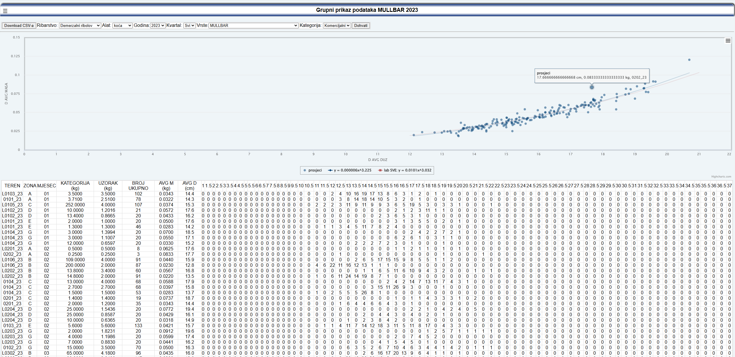
Validation of length distribution
Samples AVG length and weight

Slide 8
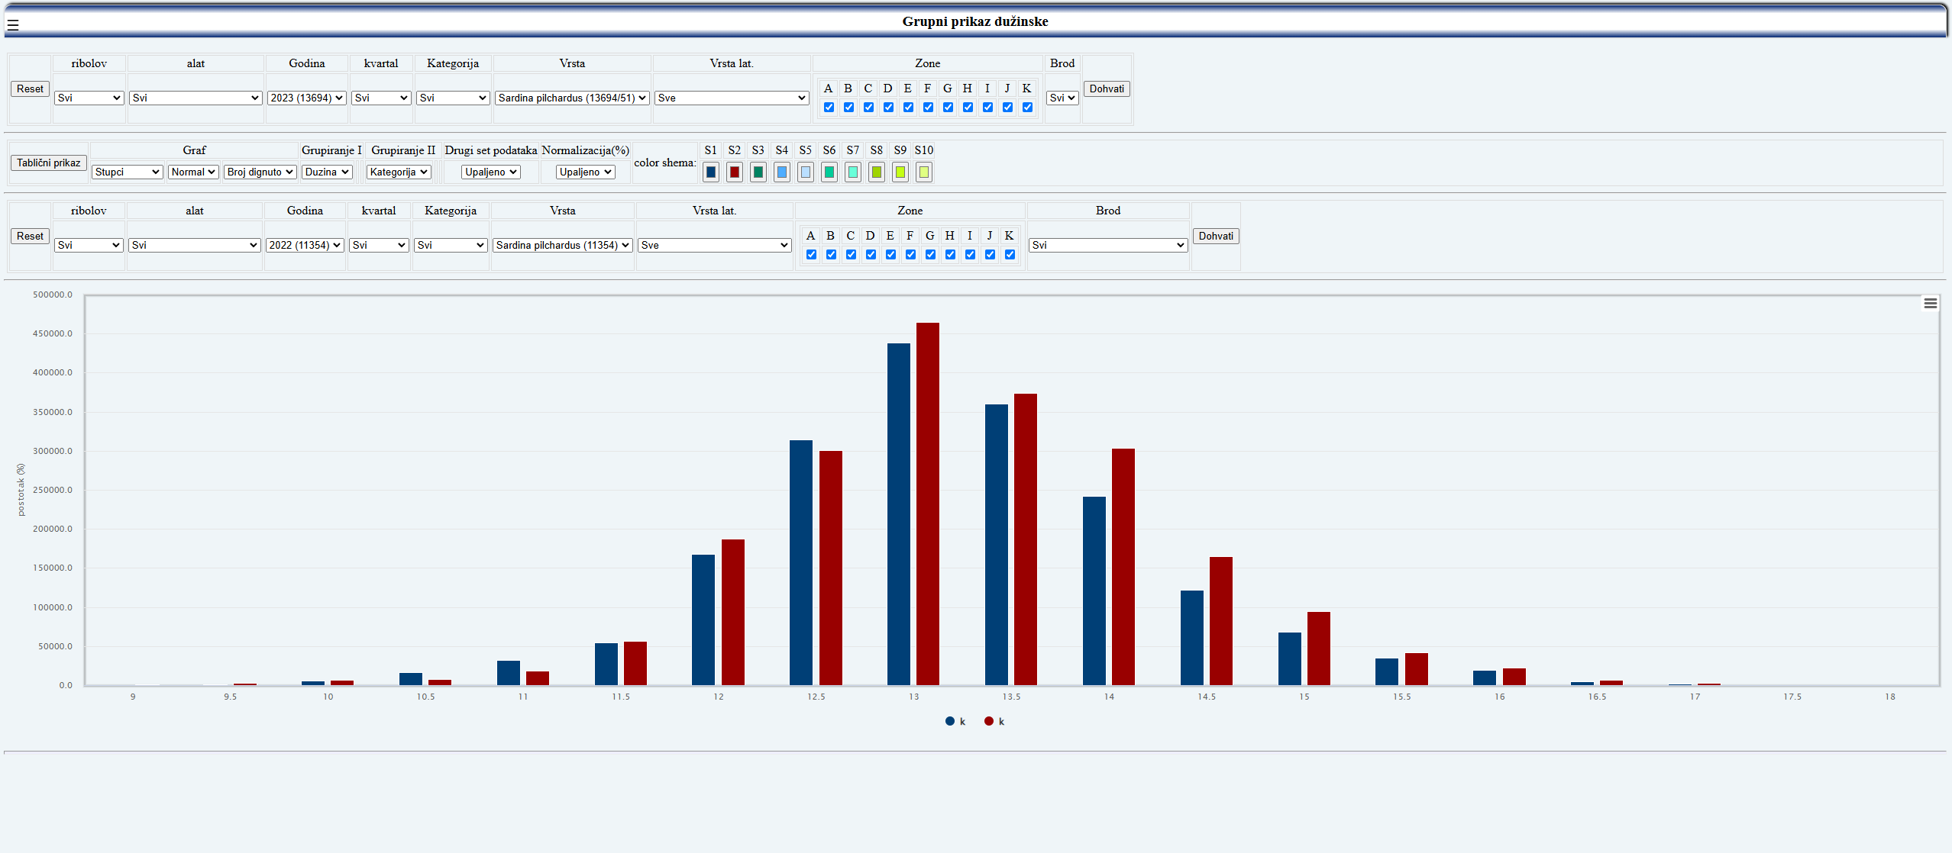
Validation of length distribution
Length frequency distribution (sardina 2022 & 2023)

Slide 9
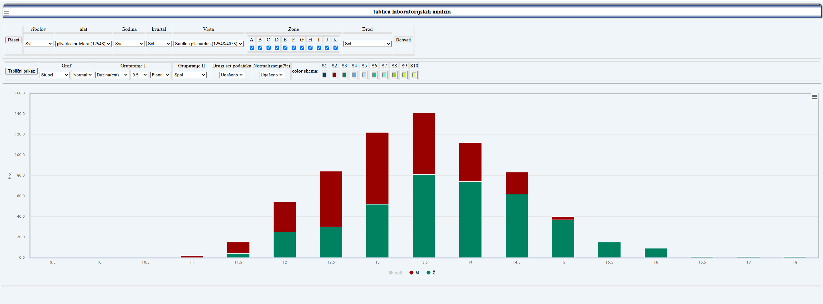
Laboratory analisys data
Sex per length frequency (Sardina)

Slide 10
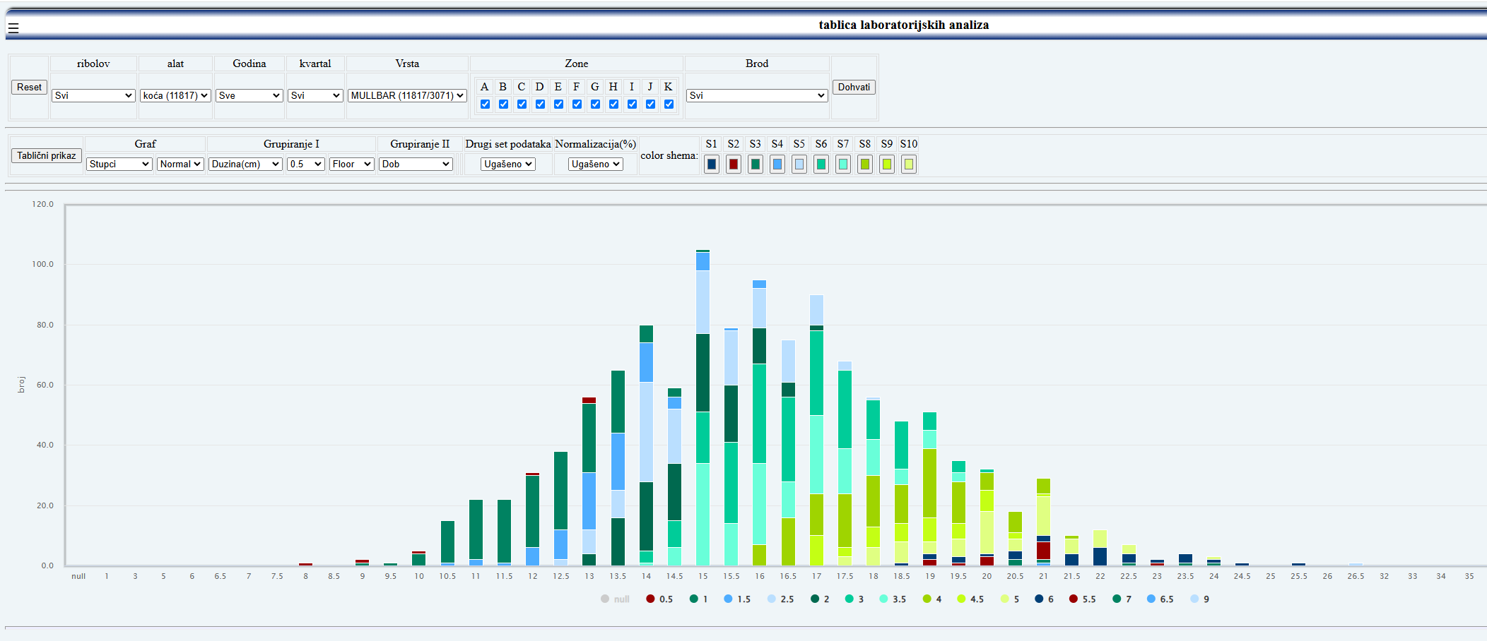
Laboratory analisys data
Age per length frequency (Mullbar)

Slide 11
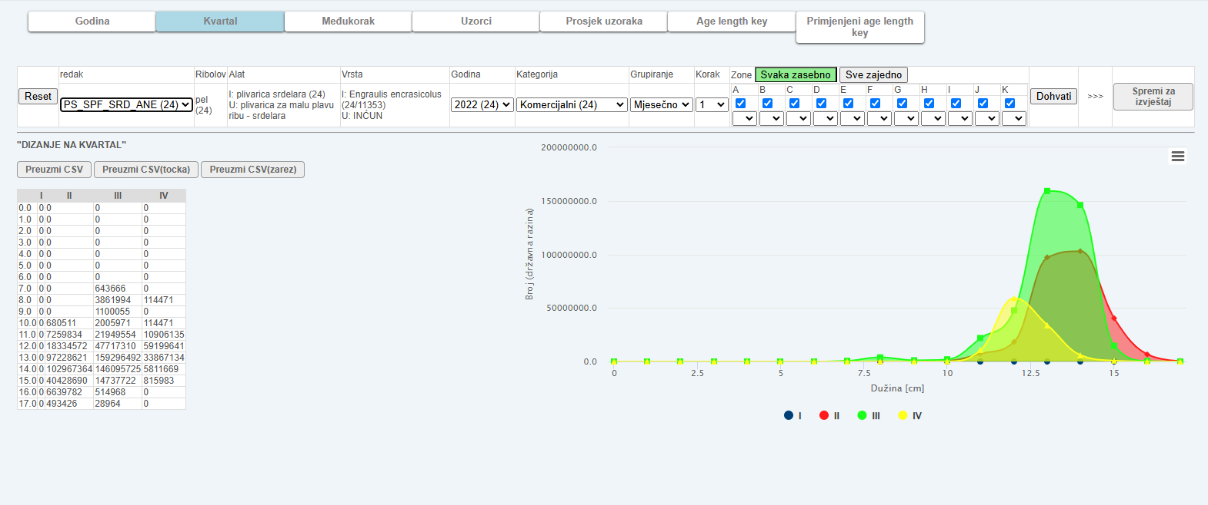
Reports building app
Parameters for calculations are set in application and sent to SQL query which returns result

Slide 12
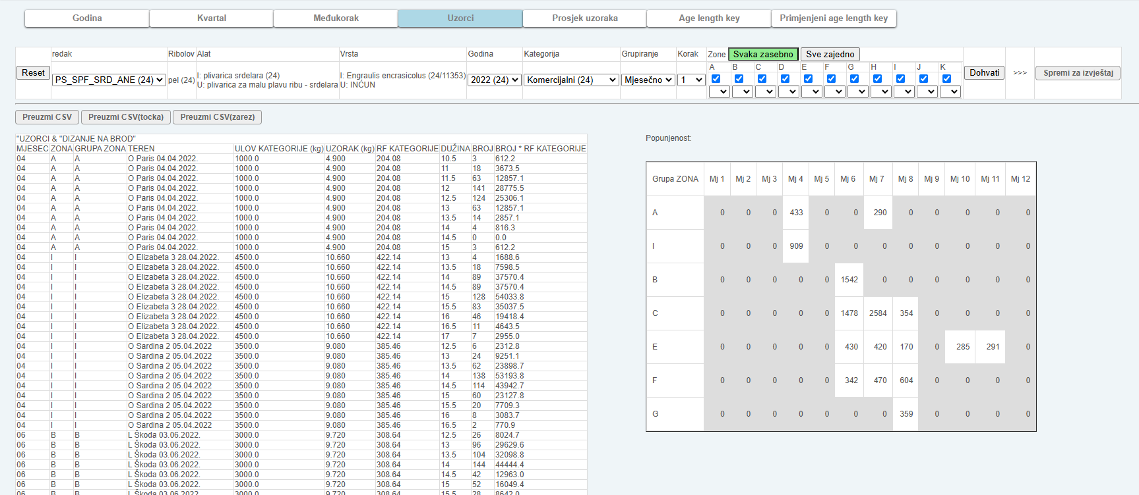
Reports building app
Sample coveradge influences best agregation approach (month, quarter, year, & how zones are combined )

Slide 13
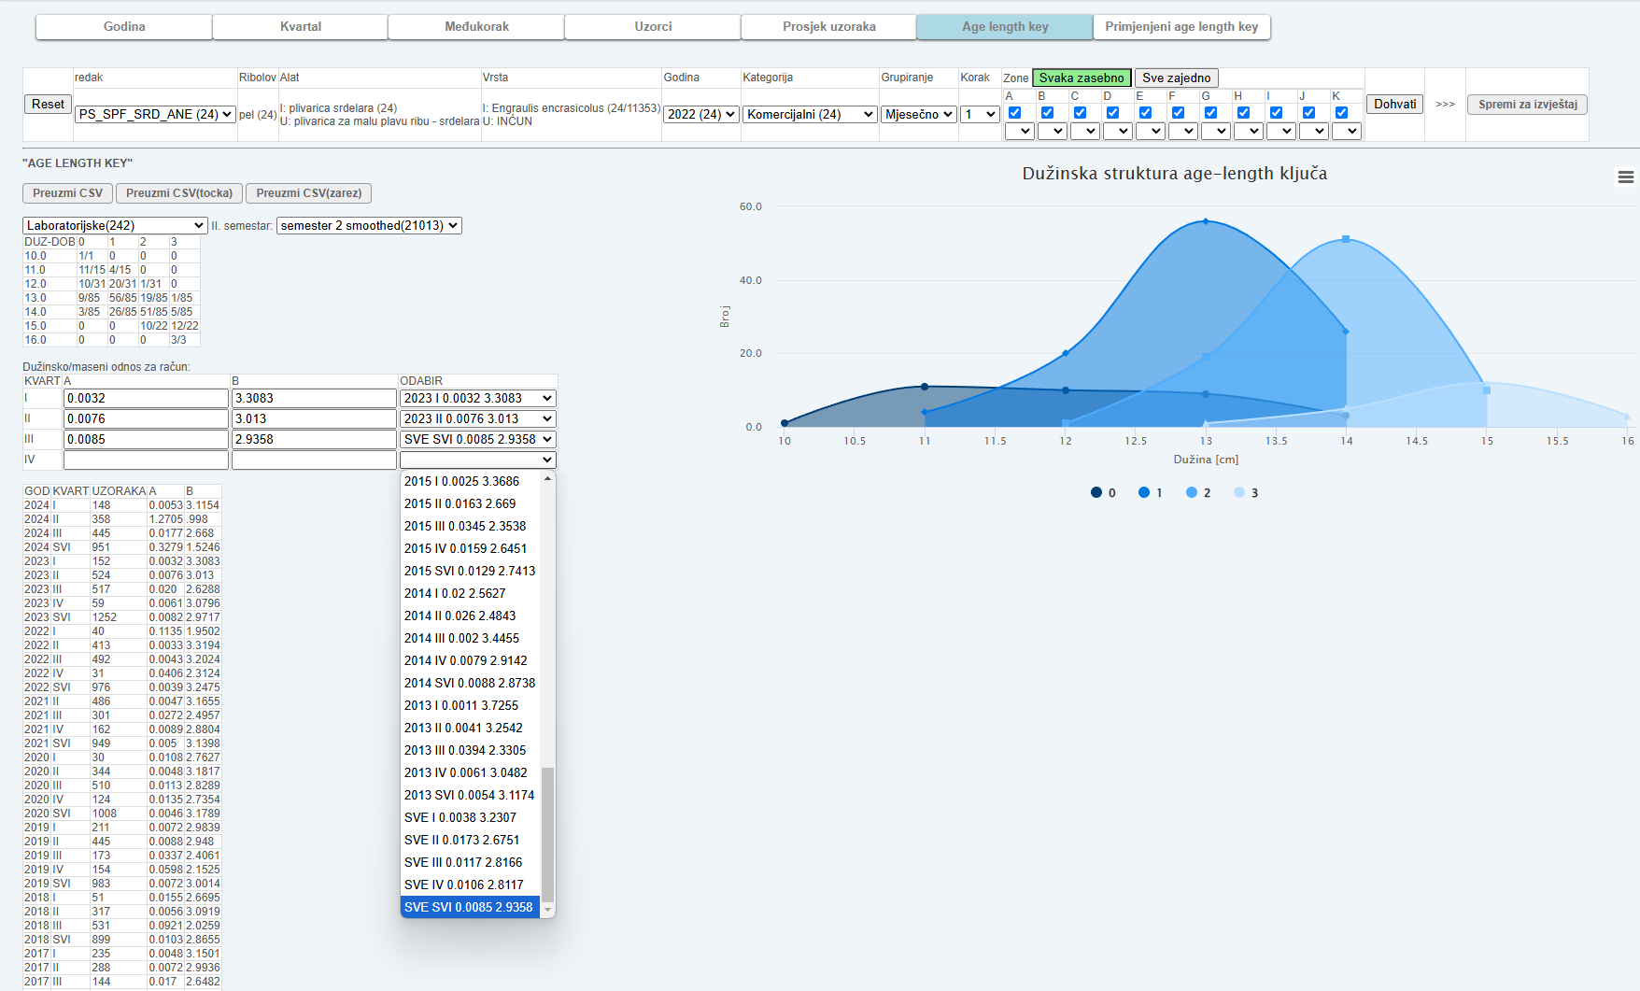
Reports building app
Choosing age-length key and length-weight function

Slide 14
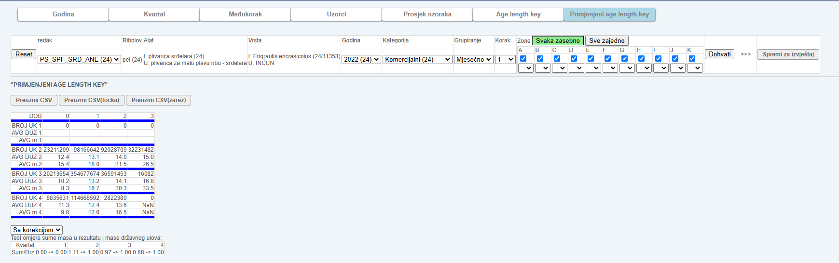
Reports building app
Quality control and correction

Slide 15
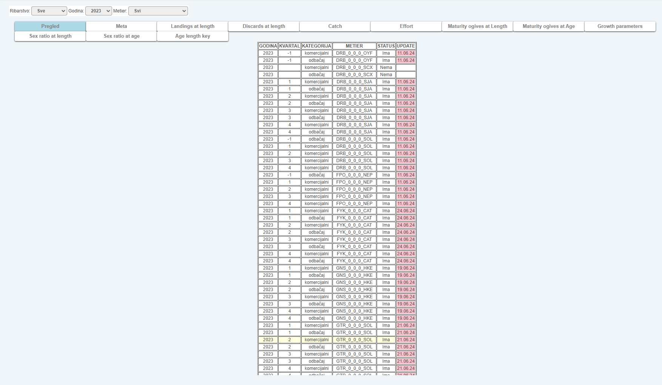
Reports overview and download
Reports status

Slide 16
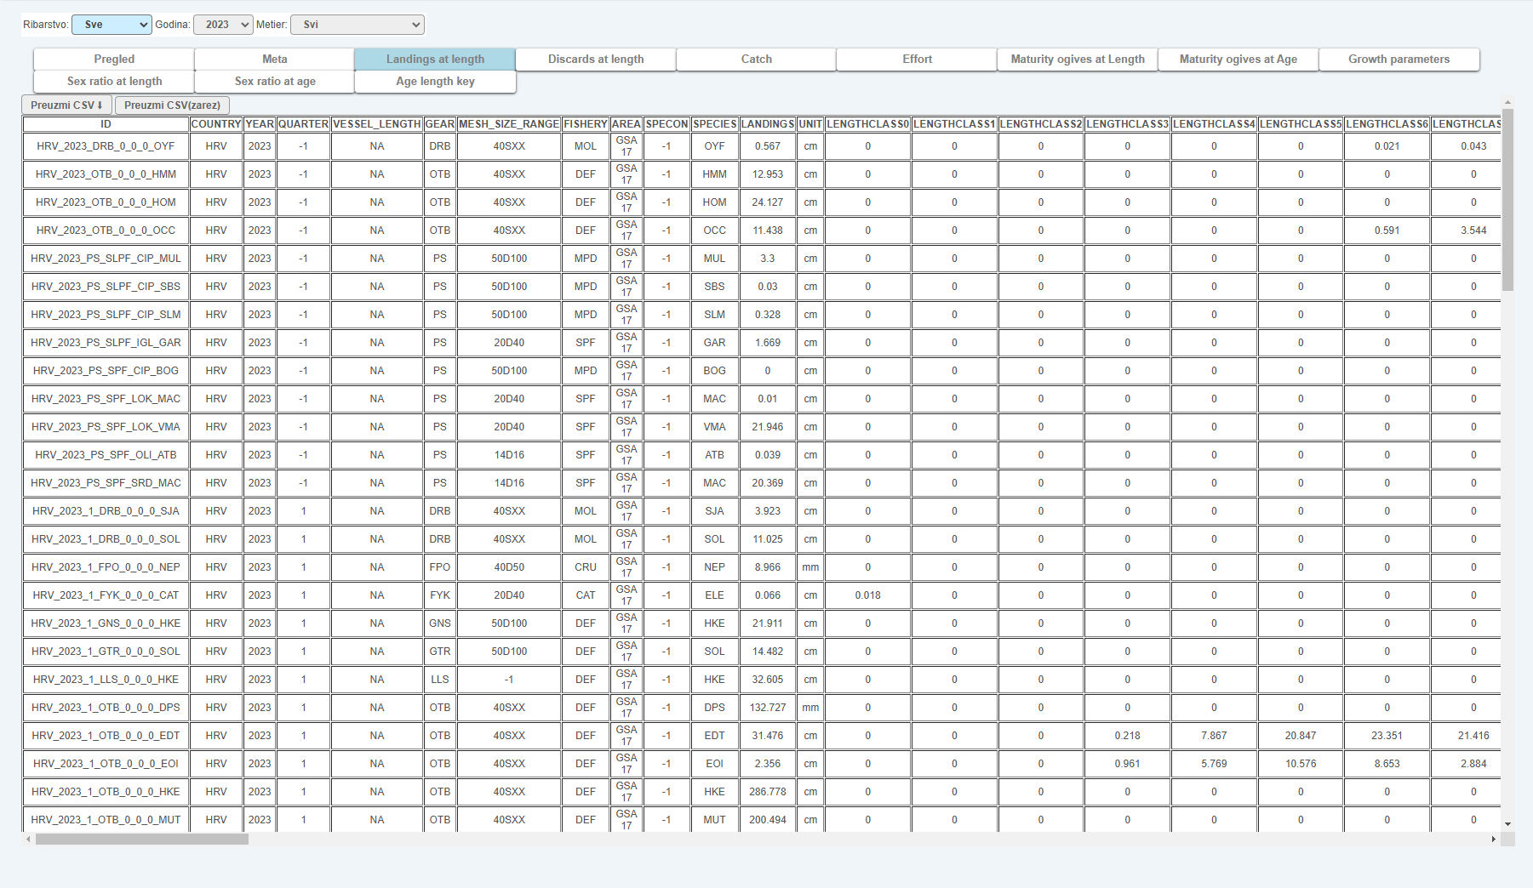
Reports overview and download
Reports download

